Slide 1
Intro to Cloud Computing CS4037 (BCS-6A) Lecture 19
Dept. of Computer Science
FAST School of Computing
NUCES Lahore

Slide 2
Module 10: Automatic Scaling and Monitoring
AWS Academy Cloud Foundations

Slide 3
Module overview
Topics
Elastic Load Balancing
Amazon CloudWatch
Amazon EC2 Auto Scaling

Slide 4
Module objectives
After completing this module, you should be able to:
Indicate how to distribute traffic across Amazon EC2 instances by using Elastic Load Balancing
Identify how Amazon CloudWatch enables to monitor AWS resources and applications in real time
Explain how Amazon EC2 Auto Scaling launches and releases servers in response to workload changes

Slide 5
Section 1: Elastic Load Balancing
Module 10: Automatic Scaling and Monitoring

Slide 6





Elastic Load Balancing
Distributes incoming application or network traffic across multiple targets in a single Availability Zone or across multiple Availability Zones.
Scales your load balancer as traffic to your application changes over time.
Elastic Load
Balancing
IP addresses
Containers
Lambda functions
EC2 instances

Slide 7
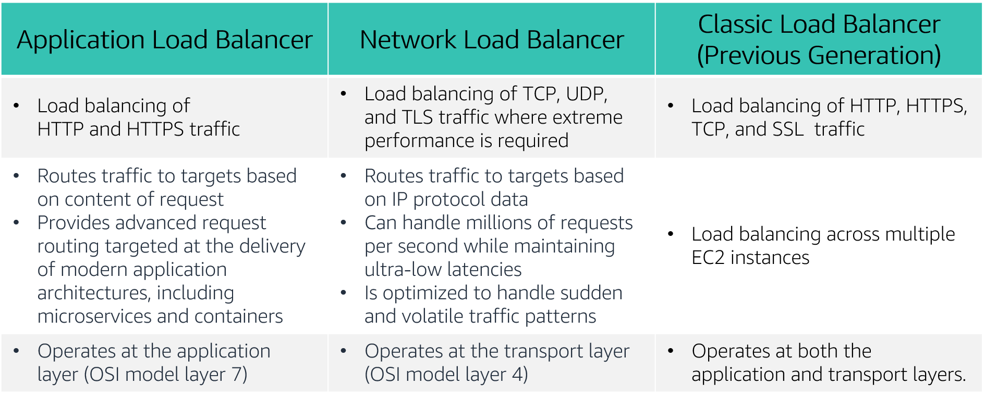
Types of load balancers

Slide 8


How Elastic Load Balancing works
With Application Load Balancers and Network Load Balancers, you register targets in target groups, and route traffic to the target groups.
With Classic Load Balancers, you register instances with the load balancer.
AWS Cloud
Load balancer accepts incoming traffic from clients.
Availability Zone A
Availability Zone B
Listener
Listener checks for connection requests.
Listener
Load balancer routes traffic only to healthy targets.
Load balancer performs health checks to monitor health of registered targets.
.
.
.
.
X
Target
Target
Target
Target
Target

Slide 9
Elastic Load Balancing Answers
You must support traffic to a containerized application.
Application Load Balancer
You have extremely spiky and unpredictable TCP traffic.
Network Load Balancer
You need simple load balancing with multiple protocols.
Classic Load Balancer
You need to support a static or Elastic IP address, or an IP target outside a VPC.
Network Load Balancer
You need a load balancer that can handle millions of requests per second while maintaining low latencies.
Network Load Balancer
You must support HTTPS requests.
Application Load Balancer

Slide 10

Section 1 key takeaways
Elastic Load Balancing distributes incoming application or network traffic across multiple targets in one or more Availability Zones.
Elastic Load Balancing supports three types of load balancers:
Application Load Balancer
Network Load Balancer
Classic Load Balancer
ELB offers instance health checks, security, and monitoring.

Slide 11
Section 2: Amazon CloudWatch
Module 10: Automatic Scaling and Monitoring

Slide 12



Amazon CloudWatch
Monitors –
AWS resources
Applications that run on AWS
Collects and tracks –
Standard metrics
Custom metrics
Alarms –
Send notifications to an Amazon SNS topic
Perform Amazon EC2 Auto Scaling or Amazon EC2 actions
Events –
Define rules to match changes in AWS environment and route these events to one or more target functions or streams for processing
Amazon
CloudWatch

Slide 13
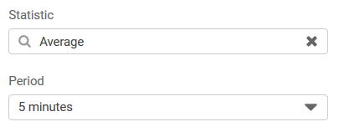
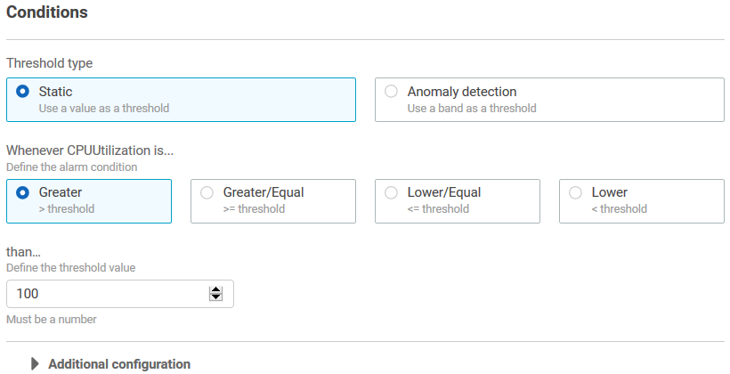
CloudWatch alarms
Create alarms based on –
Static threshold
Anomaly detection
Metric math expression
Specify –
Namespace
Metric
Statistic
Period
Conditions
Additional configuration
Actions

Slide 14




Amazon CloudWatch Alarms
If average CPU utilization is > 60% for 5 minutes…
Correct!
Amazon EC2
If the number of simultaneous connections is > 10 for 1 minute…
Correct!
Amazon RDS
If the maximum bucket size in bytes is around 3 for 1 day…
Incorrect. Around is not a threshold option. You must specify a threshold of >, >=, <=, or <.
Amazon S3
If the number of healthy hosts is < 5 for 10 minutes…
Correct!
Elastic Load Balancing
If the volume of read operations is > 1,000 for 10 seconds…
Incorrect. You must specify a statistic (for example, average volume).
Amazon Elastic Block Store

Slide 15
Section 2 key takeaways
Amazon CloudWatch helps you monitor your AWS resources—and the applications that you run on AWS—in real time.
CloudWatch enables you to –
Collect and track standard and custom metrics.
Set alarms to automatically send notifications to SNS topics, or perform Amazon EC2 Auto Scaling or Amazon EC2 actions.
Define rules that match changes in your AWS environment and route these events to targets for processing.

Slide 16
Section 3: Amazon EC2 Auto Scaling
Module 10: Automatic Scaling and Monitoring

Slide 17
Why is scaling important?
Unused
capacity
Over
capacity
Su M T W Th F Sa
Su M T W Th F Sa
Used capacity (demand)
Provisioned capacity

Slide 18
Amazon EC2 Auto Scaling
Helps you maintain application availability
Enables you to automatically add or remove EC2 instances according to conditions that you define
Detects impaired EC2 instances and unhealthy applications, and replaces the instances without your intervention
Provides several scaling options – Manual, scheduled, dynamic or on-demand, and predictive
Su M T W Th F Sa
Used capacity (demand)
Provisioned capacity

Slide 19


Auto Scaling groups
Auto Scaling group
An Auto Scaling group is a collection of EC2 instances that are treated as a logical grouping for the purposes of automatic scaling and management.
Minimum size
Launch or terminate instances as needed
Desired capacity
Maximum size

Slide 20
Scaling out versus scaling in
Elastic Load Balancing
Auto Scaling group
Auto Scaling group
Auto Scaling group
Base configuration
Scale out (launch instances)
Scale in (terminate instances)

Slide 21



How Amazon EC2 Auto Scaling works
What
Where
When
VPC
Maintain current number
Private subnet
Health checks
AMI
Auto Scaling group
Manual scaling
EC2 instance
Min, max, desired capacity
Scheduled scaling
Launch configuration
Auto Scaling group
Scheduled actions
AMI
Instance type
IAM role
Security groups
EBS volumes
VPC and subnets
Load balancer
Dynamic scaling
Scaling policies
Predictive scaling
AWS Auto Scaling

Slide 22



Implementing dynamic scaling
Elastic Load Balancing
Auto Scaling group
CPU utilization
If average CPU utilization is > 60% for 5 minutes…
Run Amazon EC2 Auto Scaling policy
Amazon EC2 Auto Scaling
Amazon CloudWatch

Slide 23
Section 3 key takeaways
Scaling enables you to respond quickly to changes in resource needs.
Amazon EC2 Auto Scaling maintains application availability by automatically adding or removing EC2 instances.
An Auto Scaling group is a collection of EC2 instances.
A launch configuration is an instance configuration template.
Dynamic scaling uses Amazon EC2 Auto Scaling, CloudWatch, and Elastic Load Balancing.
AWS Auto Scaling is a separate service from Amazon EC2 Auto Scaling.

Slide 24
Module wrap-up
Module 10: Automatic Scaling and Monitoring

Slide 25
Module summary
In summary, in this module you learned how to:
Indicate how to distribute traffic across Amazon Elastic Compute Cloud (Amazon EC2) instances using Elastic Load Balancing.
Identify how Amazon CloudWatch enables you to monitor AWS resources and applications in real time.
Explain how Amazon EC2 Auto Scaling launches and releases servers in response to workload changes.

Slide 26
AWS certification exam information

Slide 27
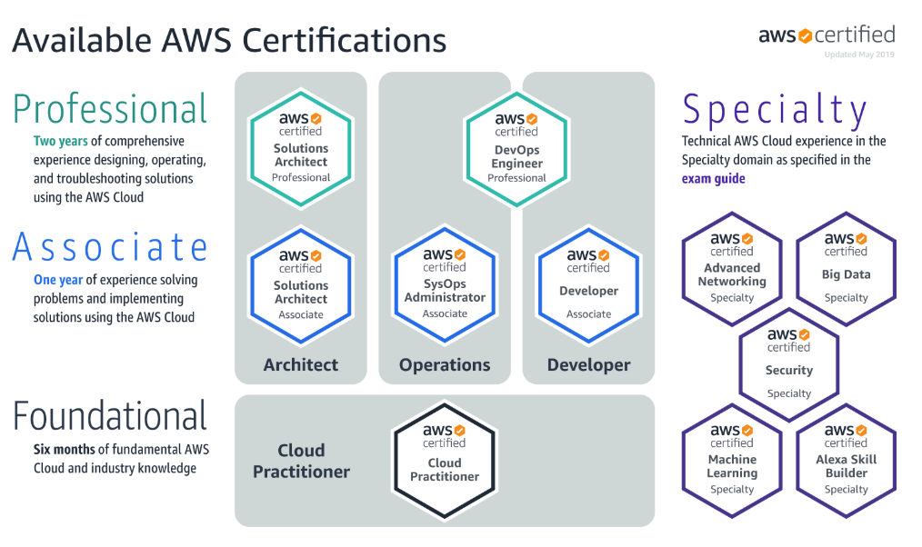
AWS certification exams
This course helps prepare you for the AWS Cloud Practitioner certification exam

Slide 28

AWS Certified Cloud Practitioner exam
Details about the exam—including how to register for it—are at https://aws.amazon.com/certification/certified-cloud-practitioner/
Practice Questions Sites
https://www.examtopics.com/exams/amazon/aws-certified-cloud-practitioner/
https://www.daypo.com/buscar.php?t=CLF-C01

Slide 29
Thank you
All trademarks are the property of their owners.

